Slide 1
HR Analytics for MMZY Company
Capstone Project Presentation
By Ahmed Satti

Slide 2
Introduction
Analysis of HR data to provide actionable insights.
Focus on employee turnover, recruitment efficiency, absence, and leadership.
Using Python-based data analytics to explore workforce trends.
Goal: Enhance decision making for MMZY Company.

Slide 3
Mission Statement
To utilize HR data analytics to help MMZY Company identify key workforce trends and provide recommendations to optimize:
• Retention.
• Hiring.
• Performance management.
Leading to cost savings and improved operational efficiency.

Slide 4
Question 1: Employee Turnover Analysis What factors drive employees to leave?
Findings:
High turnover in Production and IT/IS Departments.
Employees with lower satisfaction scores tend to leave more frequently.
Production Technician I and II positions experience higher turnover rates.
Financial Impact:
Average turnover cost per employee: $5,000-$10,000.
Reducing turnover by 10% could save: $500,000-$1 million annually.
Recommendations:
Enhance work conditions and benefits in high-turnover departments.
Establish exit interview process to analyze departure reasons.
Provide more support and development opportunities for entry-level employees.

Slide 5
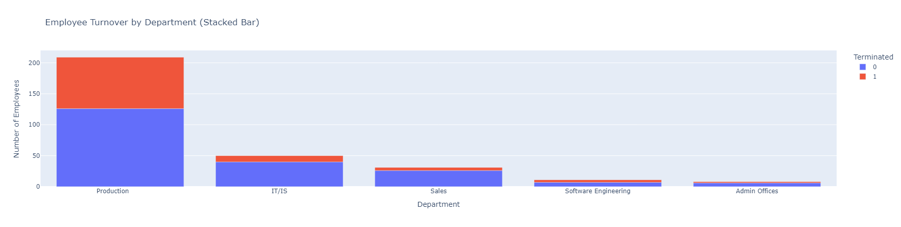
Question 1: Visualizations Employee Turnover by Department

Slide 6
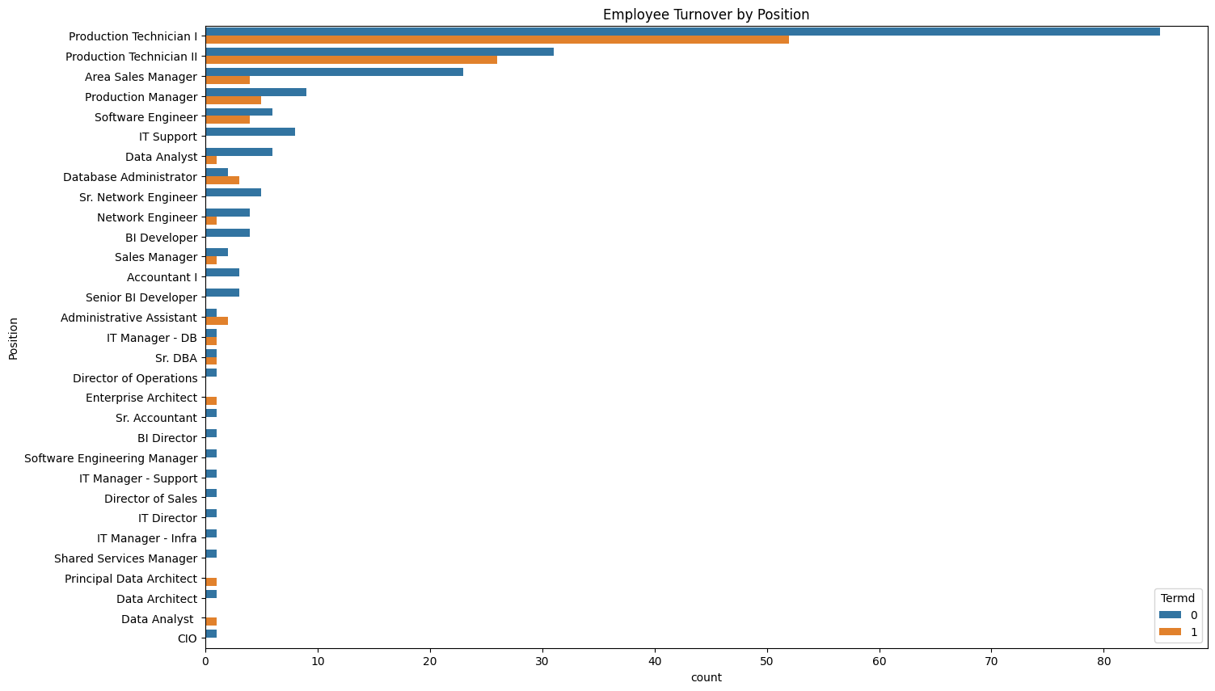
Question 1: Visualizations Employee Turnover by Position

Slide 7
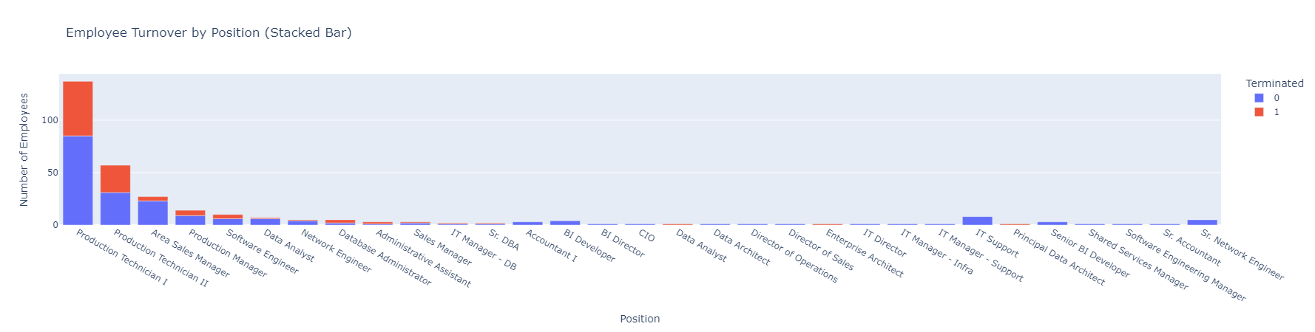
Question 1: Visualizations Employee Turnover by Position

Slide 8
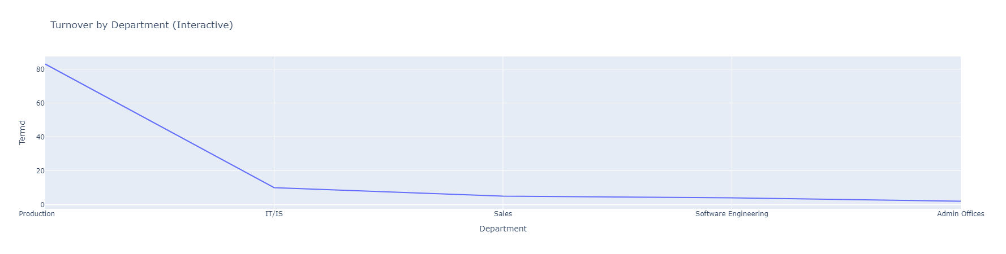
Question 1: Visualizations Employee Turnover Trend by Department

Slide 9
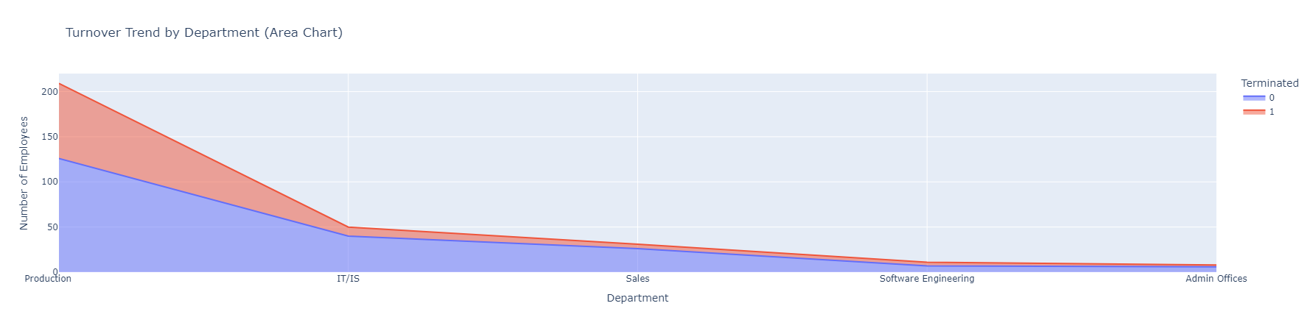
Question 1: Visualizations Employee Turnover Trend by Department

Slide 10
Question 2: Recruitment Efficiency Analysis Which hiring sources produce long-tenured, high-performing employees?
Findings:
Website and Employee Referrals produce employees with longer tenures and high performance.
Indeed, and LinkedIn hires have higher performance scores but shorter tenures.
CareerBuilder and Online Web Application show lower average tenures.
Financial Impact:
Reducing reliance on external agencies could cut hiring costs by 15-20%.
Recommendations:
Invest in training for employees recruited via Indeed and LinkedIn to increase retention.
Focus on Website recruitment for long-tenured, high-performing employees.
Investigate why high performers with "Exceeds" performance scores have shorter tenures.

Slide 11
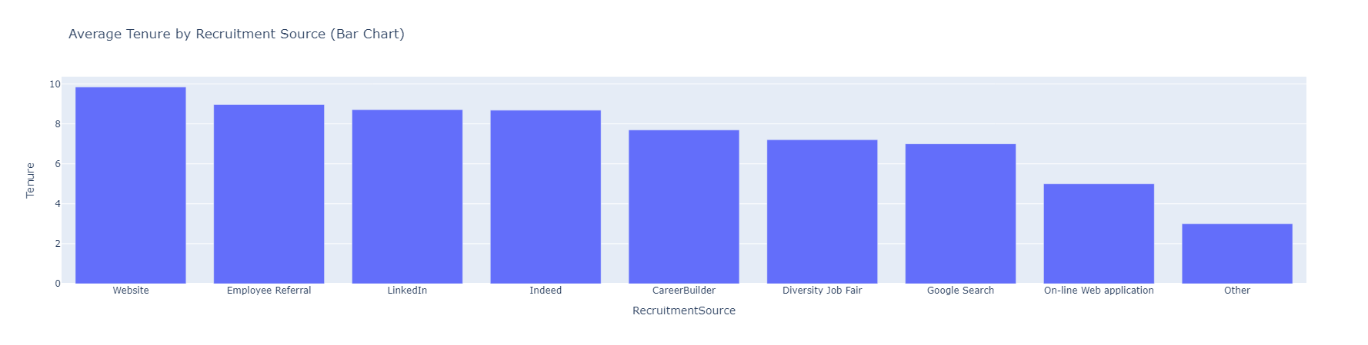
Question 2: Visualizations Average Tenure by Recruitment Source

Slide 12
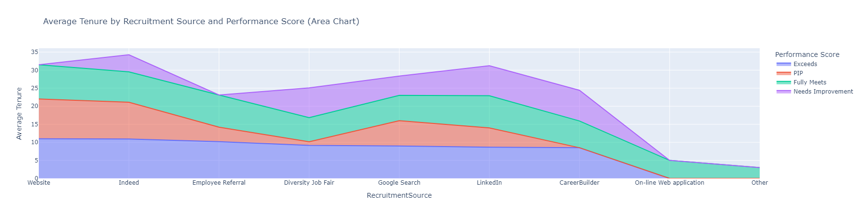
Question 2: Visualizations Average Tenure by Recruitment Source and Performance Score

Slide 13
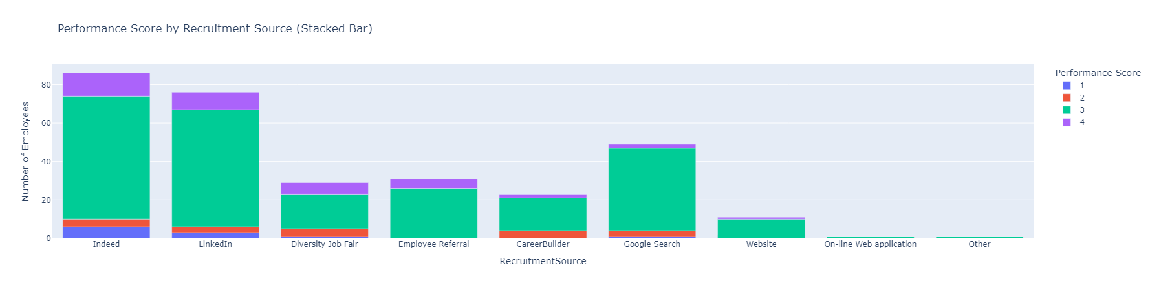
Question 2: Visualizations Performance Score by Recruitment Source

Slide 14
Question 3: Employee Absence Analysis How does absence relate to satisfaction and performance?
Findings:
Higher satisfaction generally leads to fewer absences.
Slight increase in absences at highest satisfaction level.
Employees with higher performance scores tend to have fewer absences.
Certain departments experience excessive absence.
Financial Impact:
Absence related productivity loss costs $2,000 per employee annually.
Addressing absence could save more than $200,000 annually.
Recommendations:
Focus on increasing employee satisfaction to reduce absences.
Provide additional support to high performers to maintain low absence rates.
Investigate departments with high absence rates despite good satisfaction scores.

Slide 15
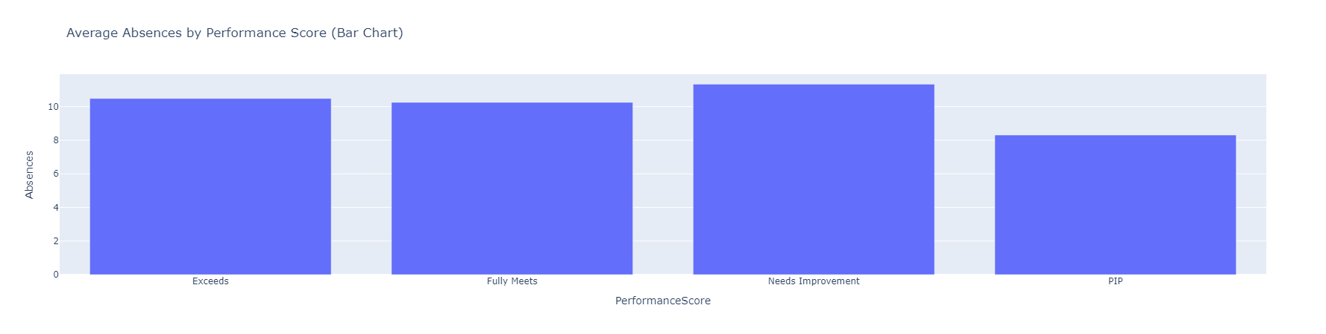
Question 3: Visualizations Average Absences by Performance Score

Slide 16
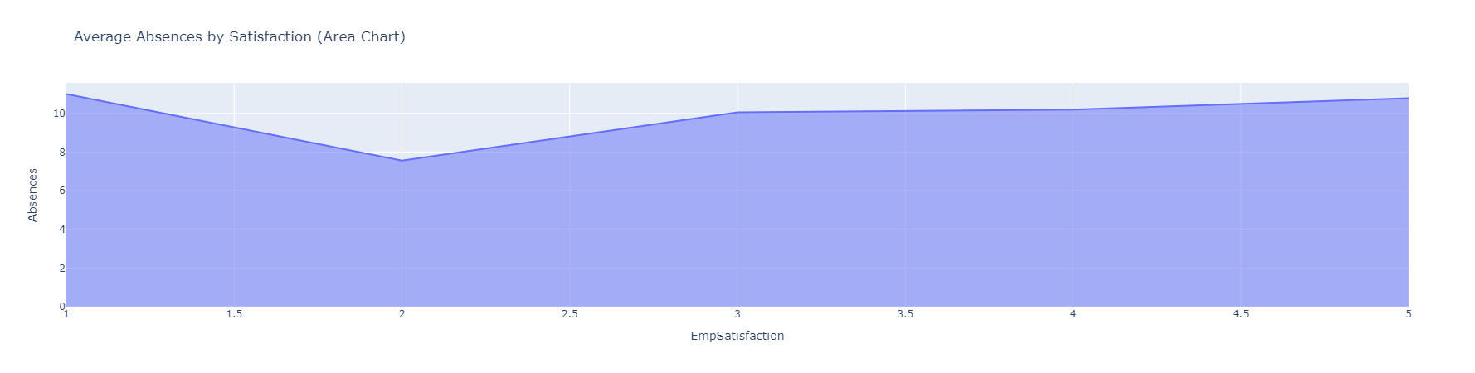
Question 3: Visualizations Average Absences by Satisfaction

Slide 17
Question 4: Leadership and Retention Analysis How do managers impact performance?
Findings:
Managers like Brannon Miller and Brian Champaigne show consistently high-performance scores.
Some managers (Debra Houlihan, John Smith) have employees with low performance scores.
Managers with higher overall scores generally have better team performance and retention.
Financial Impact:
Poor leadership can increase turnover by 20%, leading to significant hiring and training costs.
Recommendations:
Conduct leadership training for managers with high turnover rates.
Encourage high performing managers to share best practices.
Implement 360 degree feedback process for evaluating manager effectiveness.

Slide 18
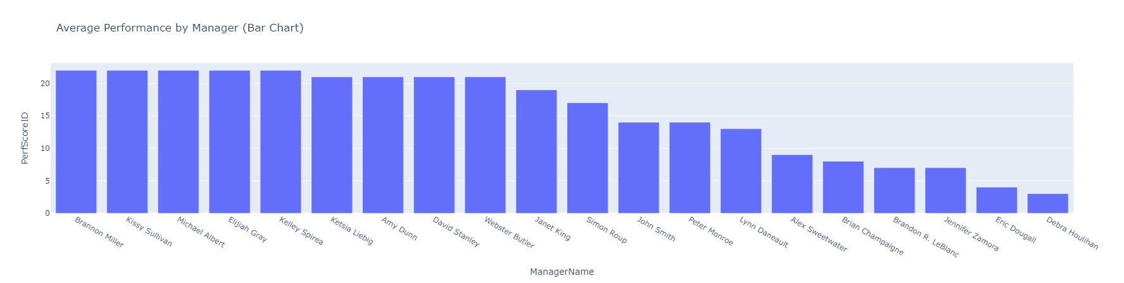
Question 4: Visualizations Average Performance by Mangers

Slide 19
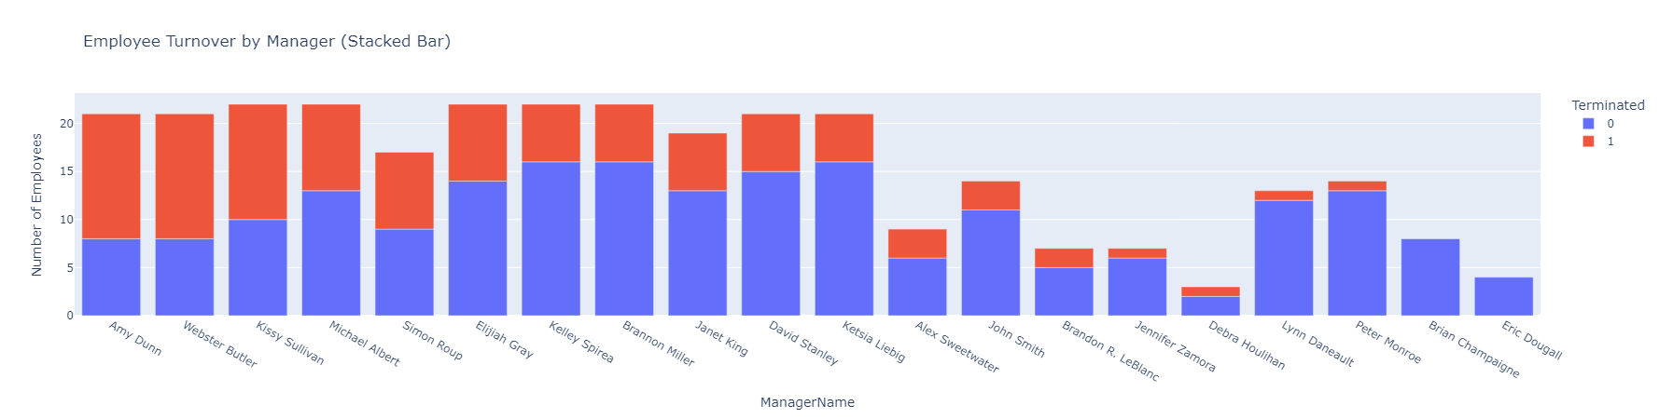
Question 4: Visualizations Employee Turnover by Manager

Slide 20
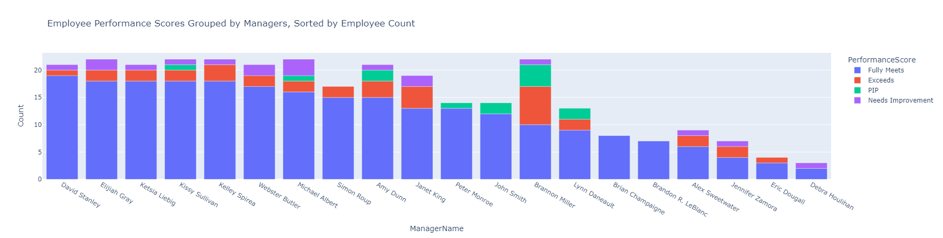
Question 4: Visualizations Employee Performance Scores Grouped by Managers, Sorted by Employee Count

Slide 21
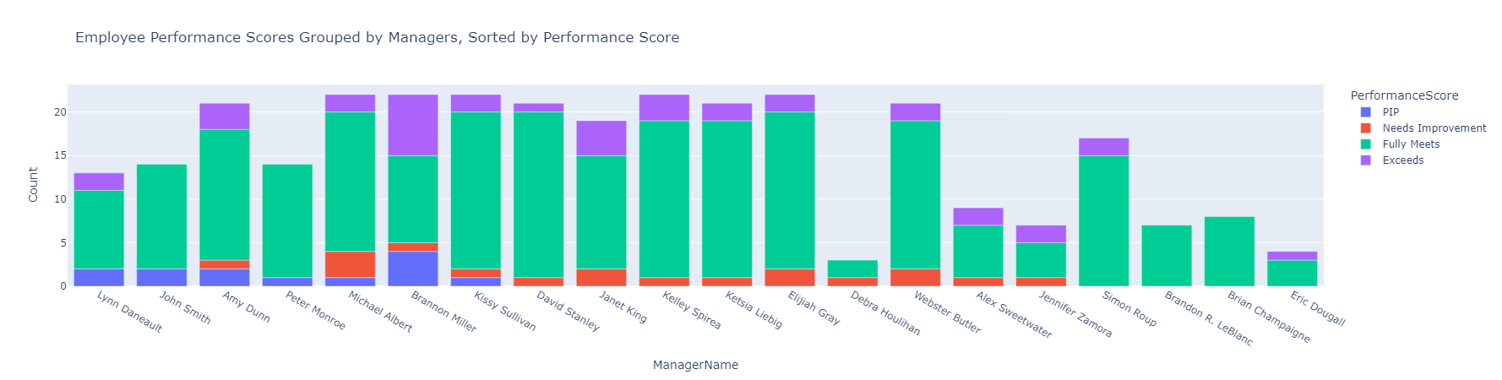
Question 4: Visualizations Employee Performance Scores Grouped by Managers, Sorted by Performance Score

Slide 22
Conclusion
Employee turnover is influenced by department, satisfaction, and position.
Website and Employee Referrals are the most effective hiring sources.
Higher absence rates are usually linked to lower satisfaction and performance.
Managers have a significant impact on team performance and retention.

